Slide 1
What you can do with automatic transcriptions A highly subjective approach
Dr. Tim Geelhaar
Hapag-Lloyd AG/Goethe University Frankfurt Main
geelhaar@em.uni-frankfurt.de
Vienna - December 18th, 2024

Slide 2
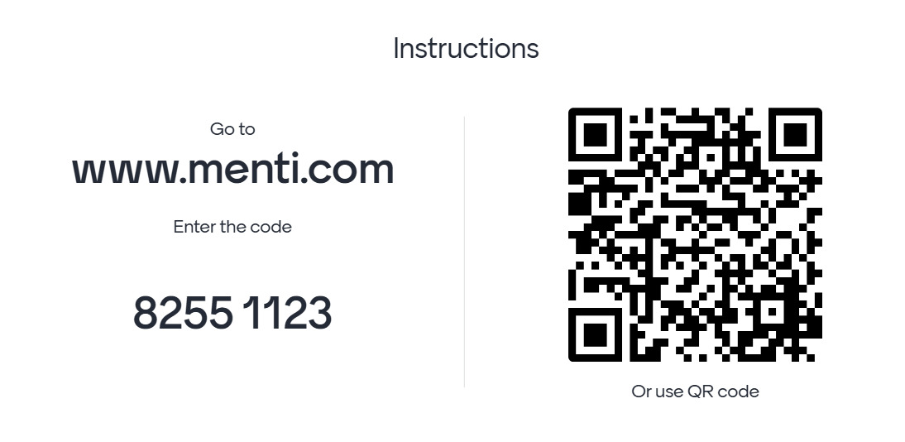
For which purpose do you create automatic transcriptions?
Notes:
Many thanks; now that you know me a bit, I would like to ask you to answer me two simples question in this survey that I created for our session today
- Go to the results and check them: Most people will not have worked with text mining or computational research methods so far

Slide 3

Text mining (TM) Textual data mining (TDM) Computational text analysis (CTA) distant reading machine learning Computational historical research Digital Theology, Digital Philology etc.
Notes:
Franco Moretti – Italian literary historian and theorist, professor emeritus from Stanford University
Computational Text Analysis (CTA) is an umbrella term for an array of digital tools and quantitative techniques that harness the power of computers and software to analyze digital texts, from individual texts to big (textual) data.

Slide 4
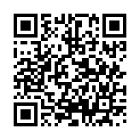
Agenda
https://github.com/TimGeelhaar/Vienna2024textmining
Definitions of text mining
Text mining: Areas of application
Example: word usage of hospitalitas
Do it yourself: AntConc & Voyant tools
Extending the workflow: Natural Language Processing (NLP)
Examples: Nopaque
Databases: Searching & Analysing
Outlook: Advanced text mining

Slide 5
What is text mining?
… (also called text data mining or text analytics) is, … a method for drawing out content based on meaning and context from a large body (or bodies) of text. … it is a method for gathering structured information from unstructured text.
Matthew Phillpott https://port.sas.ac.uk/mod/book/view.php?id=554 (2021/05/09)
„… is an artificial intelligence (AI) technology that uses natural language processing (NLP) to transform the free (unstructured) text in documents and databases into normalized, structured data suitable for analysis or to drive machine learning (ML) algorithms.“
https://www.linguamatics.com/what-text-mining-text-analytics-and-natural-language-processing (2021/05/09)
… process of extracting valuable insights, patterns, and knowledge from unstructured text data using computational techniques. It involves analyzing large volumes of text to discover meaningful information through methods like natural language processing, statistical analysis, and machine learning.
https://claude.ai/chat/017af4df-7968-4038-b3ed-8b237fc31a03 (2024/12/15)
Notes:
Large body: text body to big to read – distant reading
Structured/ unstructured – will be explained later
Second definition adds the idea of the us of the computer

Slide 6





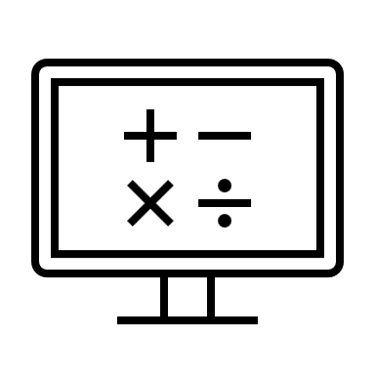
Data life cycle management
Plan & Design
Create & Collect
Refine & Preprocess
Analyse & Visualize
Publish & Preserve
Share & Reuse
Share and retrain ATR models
Retrain Preprocessing
Improve data
Research question
Concept
Material (texts)
Publication of results
Publication of data
Documentation of decisions
Web scraping
ATR
Organize data and
Establish a corpus
Data extraction
Cooccurrence analysis
Visualization
(Meta)Data cleaning
Natural language processing
Annotations (e.g. NER)

Slide 7
extract information from large amounts of text – distant reading
review large amount of research literature systematically
evaluate hypotheses or bold statements
categorize texts according to their genre
(classification – Python/BERT)
identify textual patterns, text re-use and intertextuality (plagiarism – PASSIM)
digital stemmatology (stemmaweb.net)
cluster texts according to similar features topic modeling (MALLET)
identify authors or origin via stylometry (stylometric analysis – Stylo in R)
opinion/ sentiment analysis
(Python)
find networks of entities: network analysis
…
What is
text mining
good for?

Slide 8
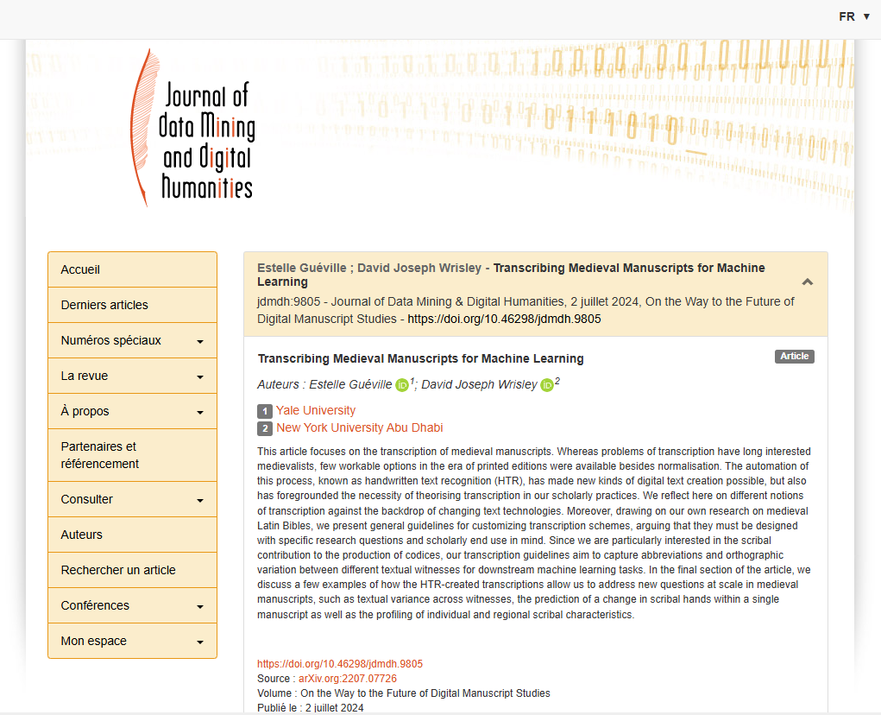
Do text mining and transcriptions go together?
https://jdmdh.episciences.org/11090

Slide 9
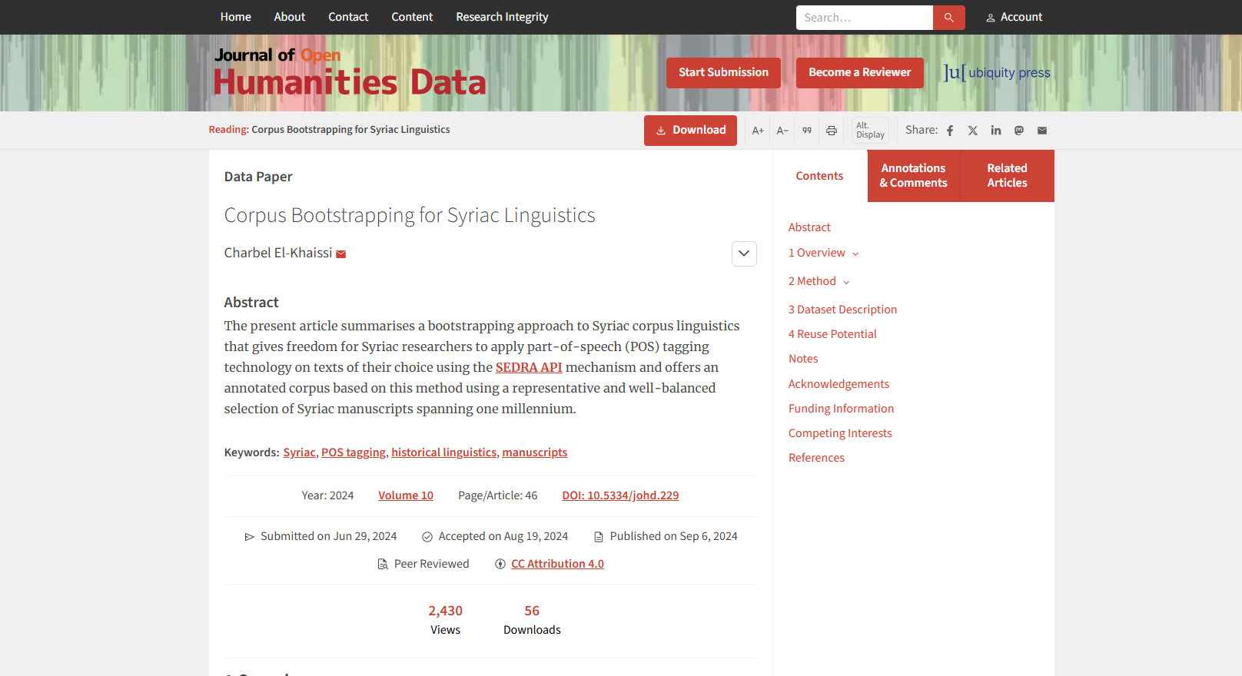
https://openhumanitiesdata.metajnl.com/articles/10.5334/johd.229
https://syriaccorpus.org/index.html

Slide 10
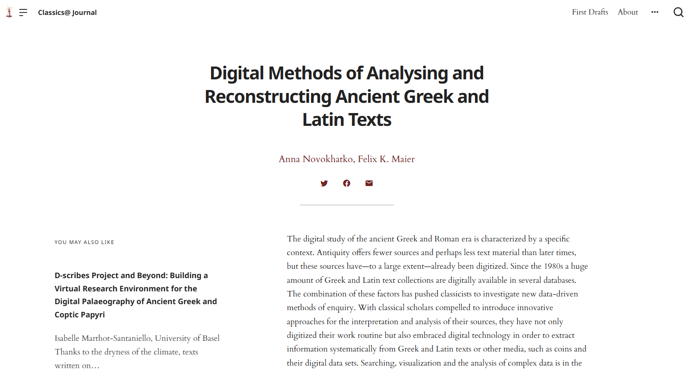
https://classics-at.chs.harvard.edu/digital-methods-of-analysing-and-reconstructing-ancient-greek-and-latin-texts/

Slide 11
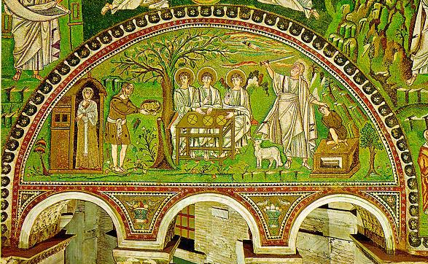
Historical Research using text mining
‘Ambiguities of Hospitality: Intercultural Integration and Conflict in Host-Guest Relations on the European Borderlands, c. 1000–1350’
(funded by the Swedish Research Council, 2021-2024)
Wojtek Jezierski, University Gothenburg
Lars Kjær, New College London
Tim Geelhaar, University Bielefeld
Tim Geelhaar, Hospitalitas: a Virtue in Danger. Semantic Observations on the Use of hospitalitas in Latin Narrative Sources, 1000-1400, in: Wojtek Jezierski, Lars Kjær (eds.), Guests, Strangers, Aliens, Enemies. Ambiguities of Hospitality in the Latin Middle Ages, 1000-1350 (Turnhout: Brepols, 2025)
Abraham and Sarah entertain the three angels. Detail from a mosaic above the arches on the north wall of Church of St. Vitale, Ravenna, Italy (526-548 AD).
Central Question: How did the meaning of the term hospitalitas evolve and which role played the ambiguity of host-guest relations?

Slide 12
Theory: defining corpora – repository vs. corpus
repository
a collection of objects
(mostly written evidence)
assembled rather arbitrarily
therefore unstructured,
unbalanced, and
not representative.
serves as an archive
corpus (pl. –ora)
a collection of objects
(mostly written evidence)
assembled on purpose
to be structured
balanced accord. to criteria
aims at representativeness
serves as object of research

Slide 13
The constitution of the hospitality corpus in total: 482 works by 351 authors with ca. 12 millions words

Slide 14
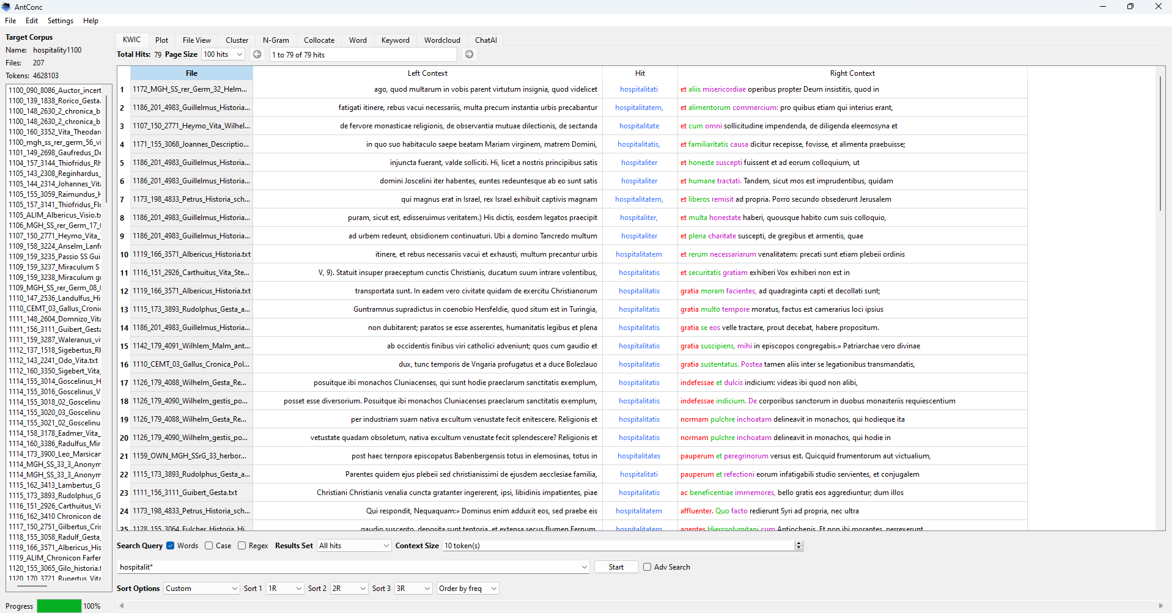
Using the tool AntConc for Text Analysis
https://www.laurenceanthony.net/software/antconc/
Notes:
First version published in 2014 by Prof. Laurence Anthony, Professor of Applied Linguistics at Waseda University, Japan.
I entered all files als plain text files into the machine, look at the dating of the texts.

Slide 15
Hospitalitas appears only 196 times in the whole corpus. Higher frequencies from the 12th c. onwards to the end of the 13th c.

Slide 16
Hospitalitas was mainly used in its Genitive Singular form, but a change takes place in the 13th century

Slide 17
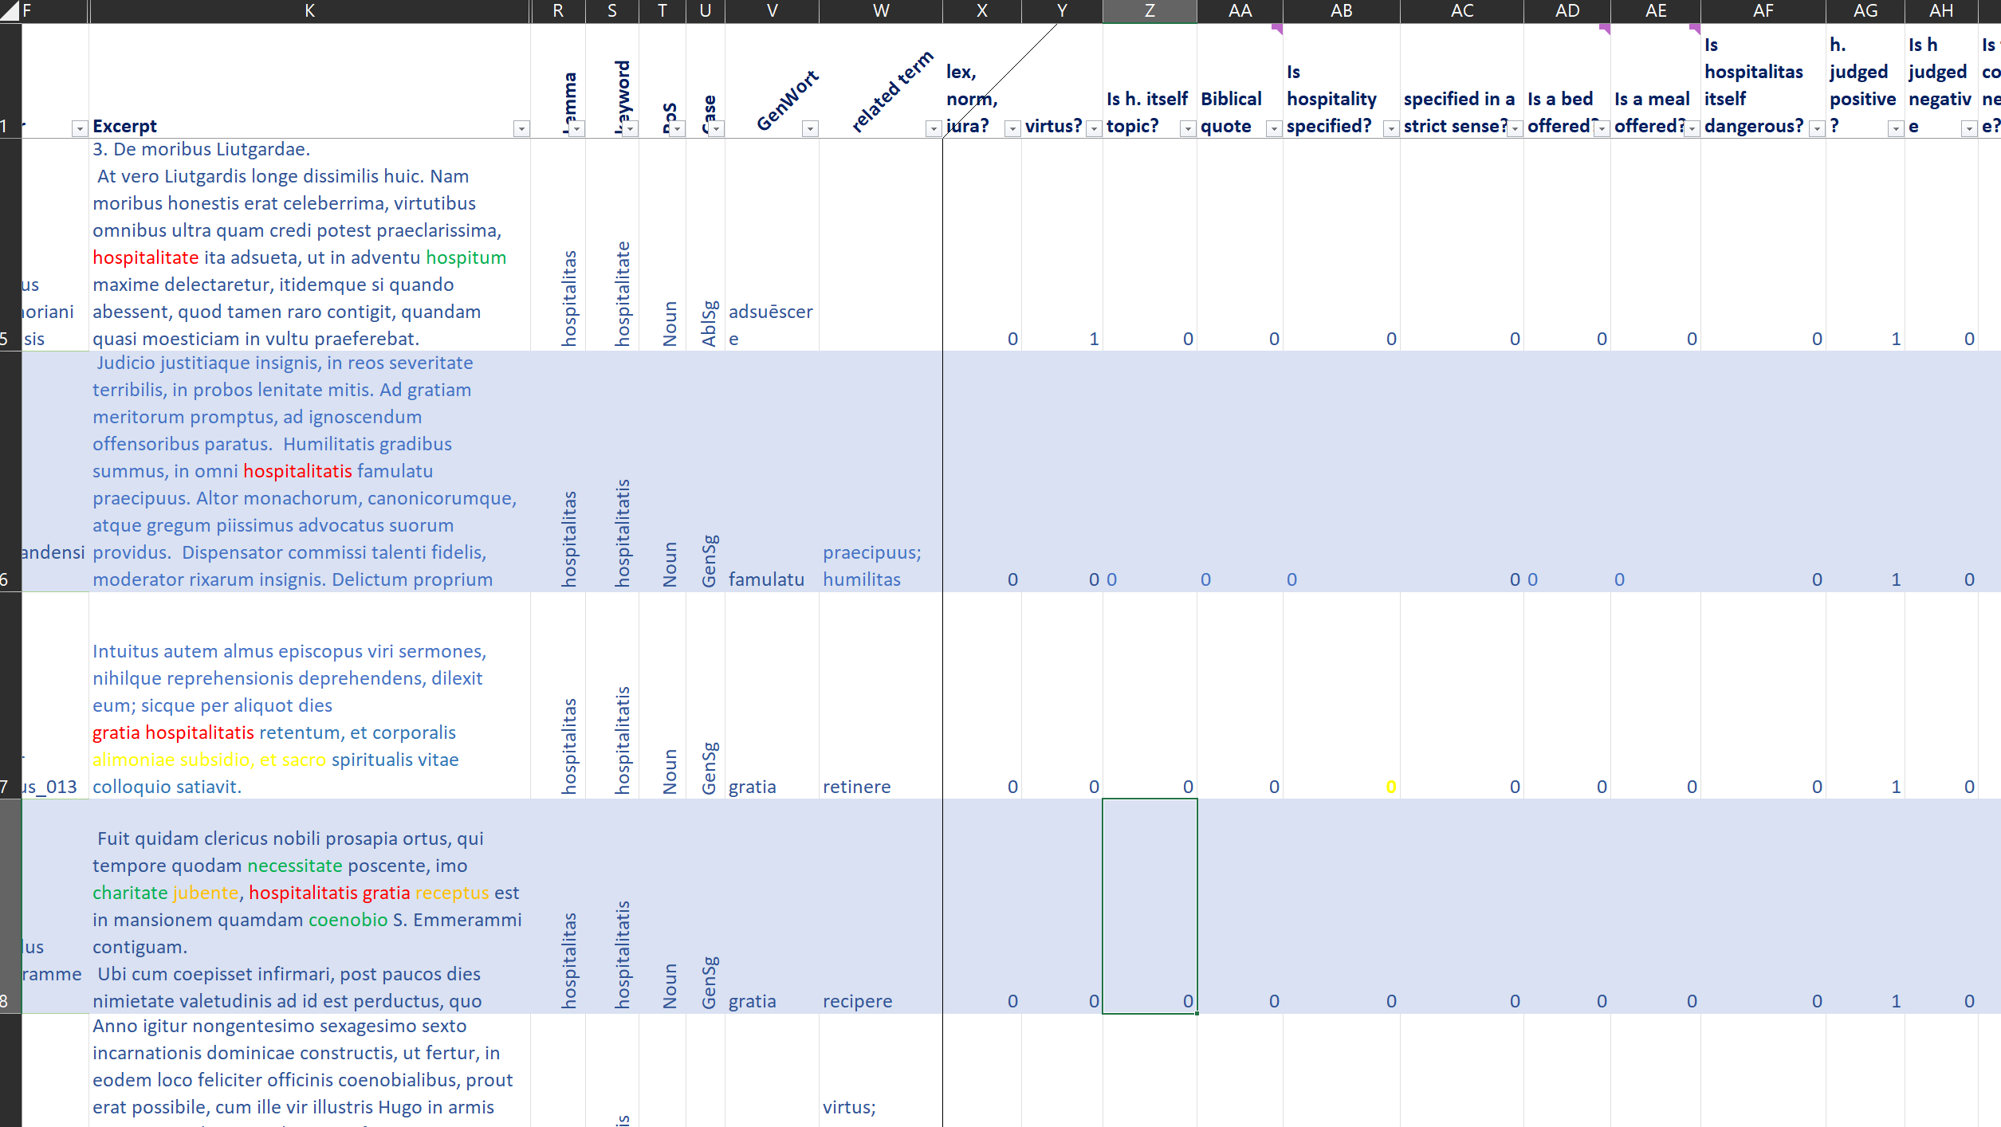
Hospitalitas as a personal virtue
Notes:
Change perspectives from distant reading to close reading – I coded 30 different questions for each of the 196 hits for hospitalitas. Result: very stable normative concept, in general monstaic background, but apparently also for non monastic audiences from the 13th century onwards. Hospitalitas shows differences in the role of hospitality. We come across a newly established saint, Julian hopsitator who should help guests on their pilgrimages and journeys at the same time when the commercialisation kicks in.

Slide 18
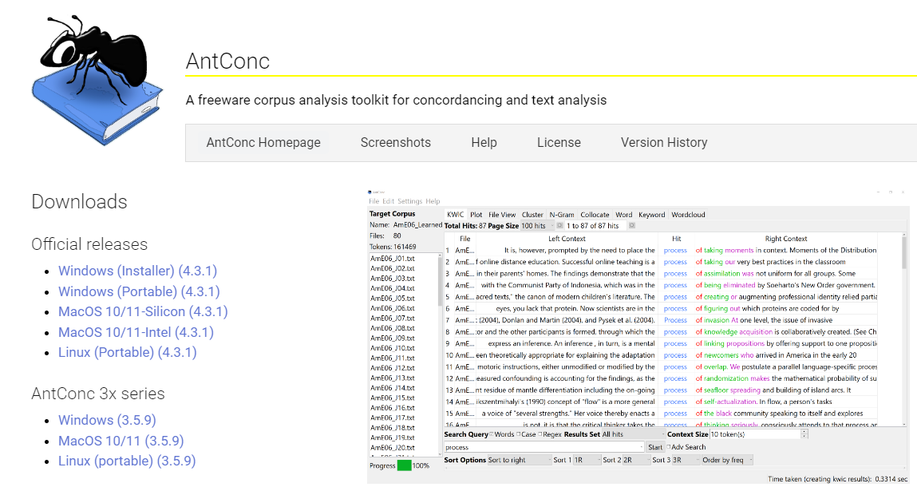
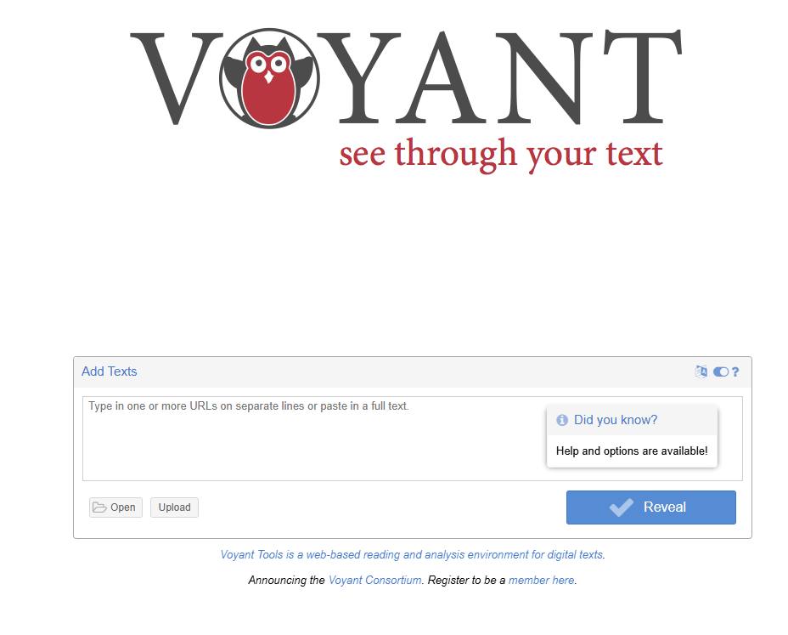
Try yourself: All you need is a text-file (.txt)
AntConc
https://www.laurenceanthony.net/software/antconc/
Voyant Tools
https://voyant-tools.org/
Notes:
Opening antconc; second tool is voyant tools

Slide 19
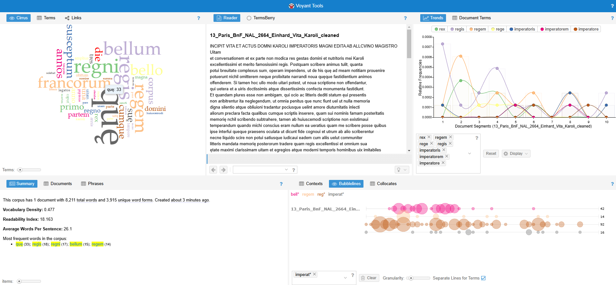
Text Mining: Voyant Tools
Link to voyant-tools
Notes:
- Not lemmatized text; trends already interesting, bubblelines below show distribution in the text.

Slide 20
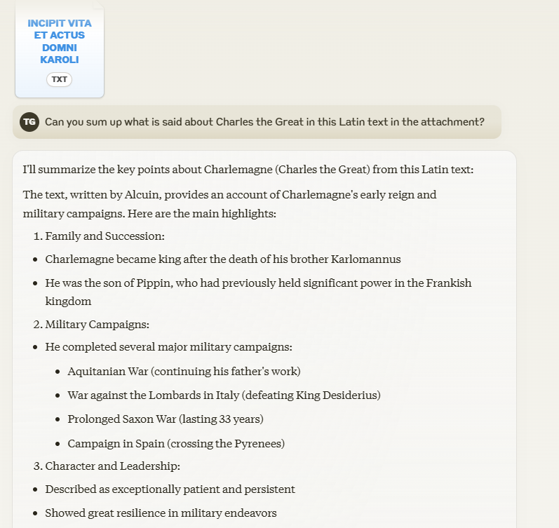
Summarizing texts with AI: eg. Claude.ai
Link to claude.ai

Slide 21
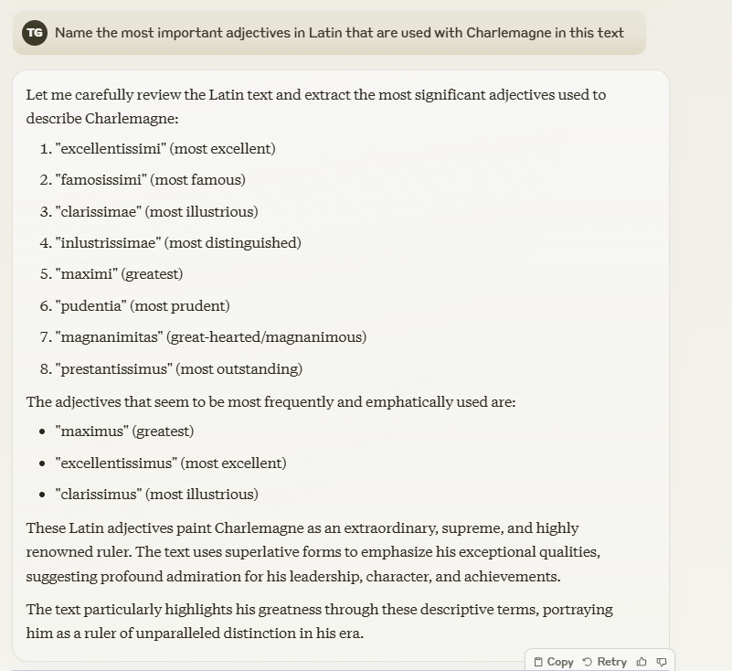
Summarizing texts with AI: eg. Claude.ai

Slide 22
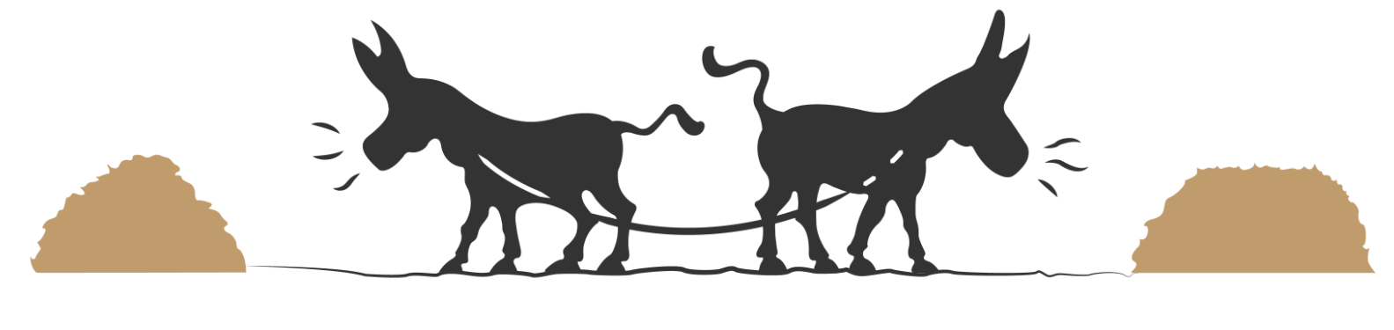
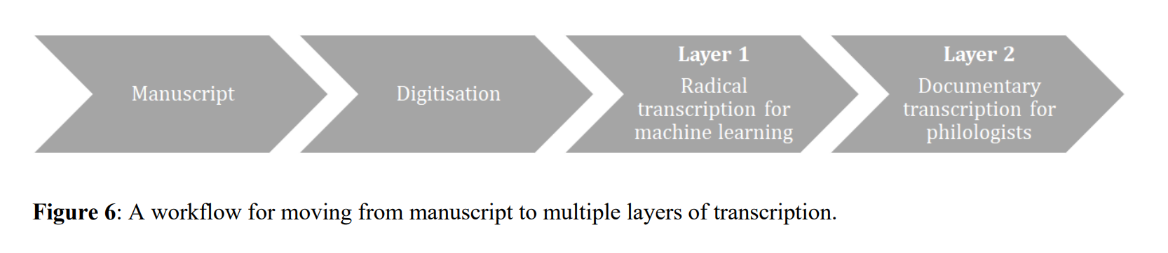
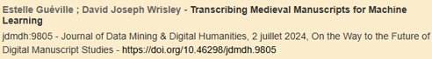
Extending the workflow: path dependency as a challenge
Critical edition
Text mining
Notes:
Path dependencies,

Slide 23
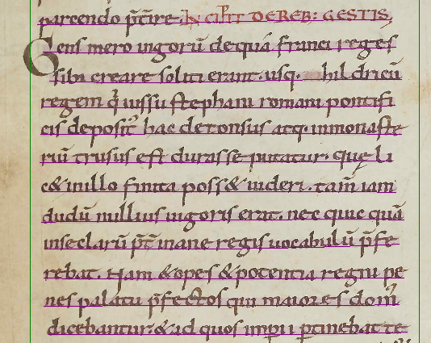
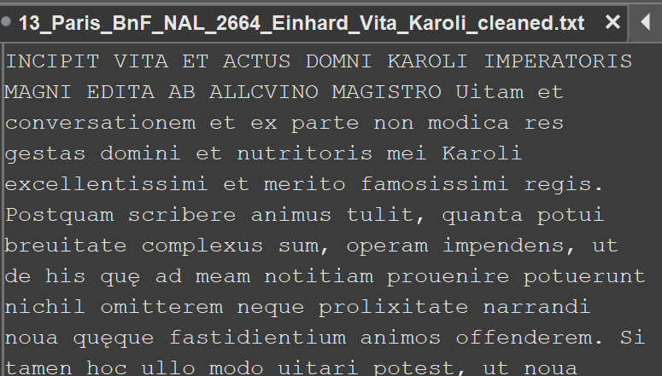
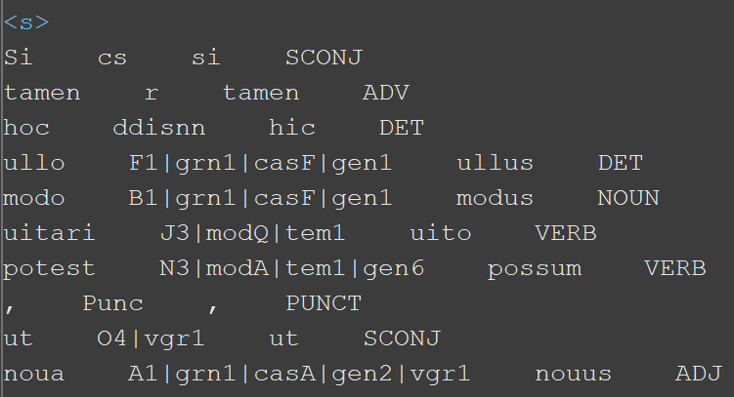
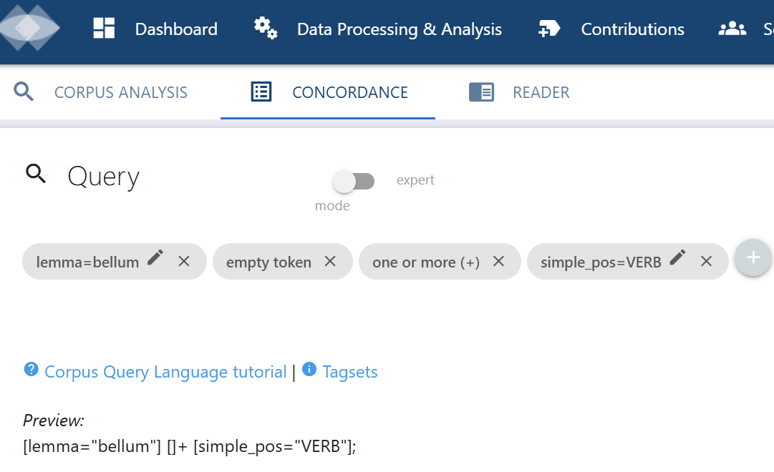
transcript export e.g. txt or xml
manuscript
(2) Normalizing the final transcript
e.g. with python scripts replacing abbreviations and special characters
(1) ATR Software e.g. Transkribus
Layout recognition
Text recognition
transcribing
(3) Post Correction & Meta data curation
e.g. with Oxygen or open refine
(4) Natural Language Processing (NLP)
e.g. with Nopaque or Spacy/Python
Vrt*-file or enriched xml-file
Sentence split, text structure
Tokenization, Lemmatization
Named entity recognition etc.
part of a corpus
(5) Corpus creation and text mining analysis
e.g. Nopaque
Corpus query
* Verticalized text file

Slide 24
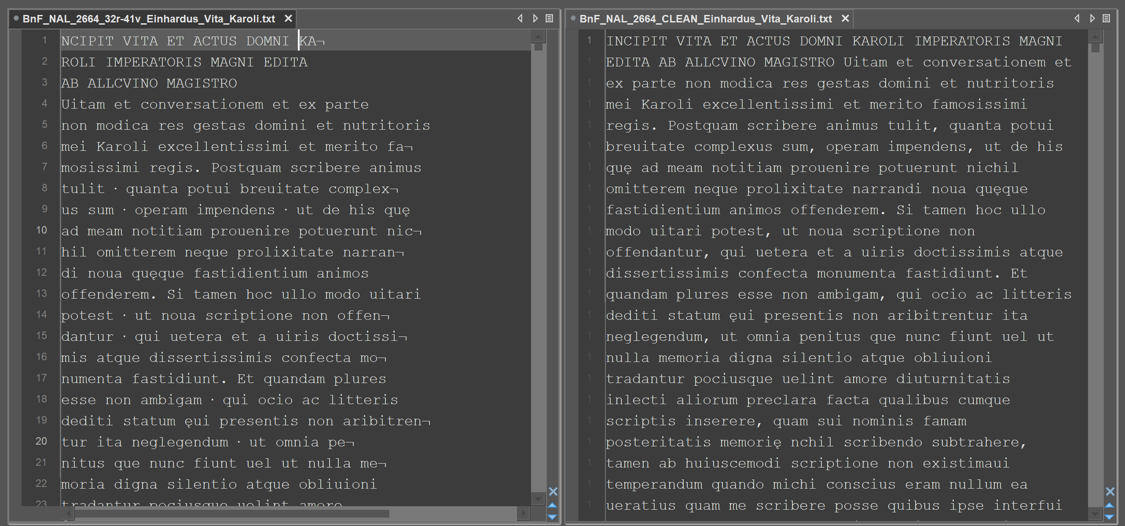
raw text from Transkribus CMM vs. cleaned text

Slide 25
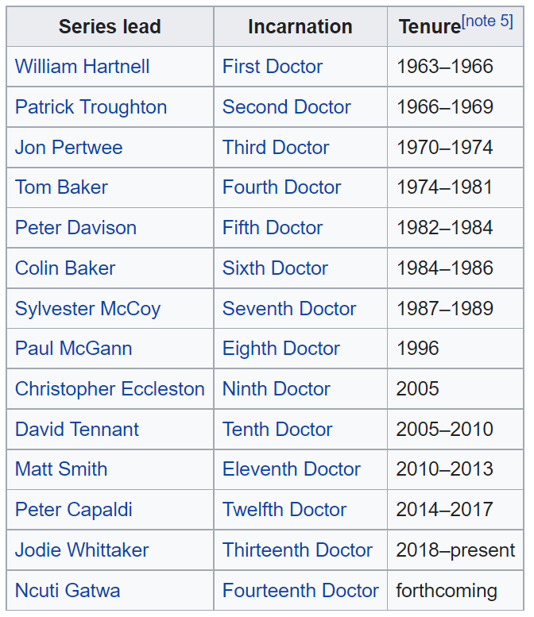

Structured? Unstructured?
Doctor Who is a British science-fiction television programme broadcast by the BBC since 1963. The programme depicts the adventures of a Time Lord called the Doctor, an extraterrestrial being who appears to be human. The Doctor explores the universe in a time-travelling space ship called the TARDIS. The TARDIS exterior appears as a blue British police box, which was a common sight in Britain in 1963 when the series first aired. With various companions, the Doctor combats foes, works to save civilisations, and helps people in need.
Beginning with William Hartnell, thirteen actors have headlined the series as the Doctor; in 2017, Jodie Whittaker became the first woman to officially play the role on television. …
From https://en.wikipedia.org/wiki/Doctor_Who

Slide 26
Structured data – Unstructured text
<text>
<s>
﻿Doctor NN ﻿doctor NOUN
Who WP who PRON
is VBZ be AUX
a DT a DET
<ent type="NORP">British JJ british ADJ</ent>
science NN science NOUN
HYPH - PUNCT
fiction NN fiction NOUN
television NN television NOUN
programme NN programme NOUN
broadcast VBN broadcast VERB
by IN by ADP
the DT the DET
<ent type="ORG">BBC NNP BBC PROPN</ent>
since IN since SCONJ
<ent type="DATE">1963 CD 1963 NUM</ent>. . . PUNCT
</s>
Doctor Who is a British science-fiction television programme broadcast by the BBC since 1963. The programme depicts the adventures of a Time Lord called the Doctor, an extraterrestrial being who appears to be human. The Doctor explores the universe in a time-travelling space ship called the TARDIS. The TARDIS exterior appears as a blue British police box, which was a common sight in Britain in 1963 when the series first aired. With various companions, the Doctor combats foes, works to save civilisations, and helps people in need.
Beginning with William Hartnell, thirteen actors have headlined the series as the Doctor; in 2017, Jodie Whittaker became the first woman to officially play the role on television. …
Machine readable structured text format
VRT = Verticalized text file for Queries in the Corpus Workbench

Slide 27
Preprocessing steps (semi-automated processes) as part of NLP
Sentence Split
Text structure recognition
Tokenization
Part-of-Speech-Tagging (PoS)
Lemmatization
Named-Entity-Recognition
Morphological information
Syntactical Parsing
Sentiment Recognition
Tagging sentence borders (interpunctuation)
Tagging the layout of the text
Recognizing words etc.
Grammatical information
Adding the lemma to the inflected word
Tagging named entities (referencing to lexicon)
Adding morphological information
Adding tags for syntatical information
Tagging sentiments (referencing to lexicon)

Slide 28
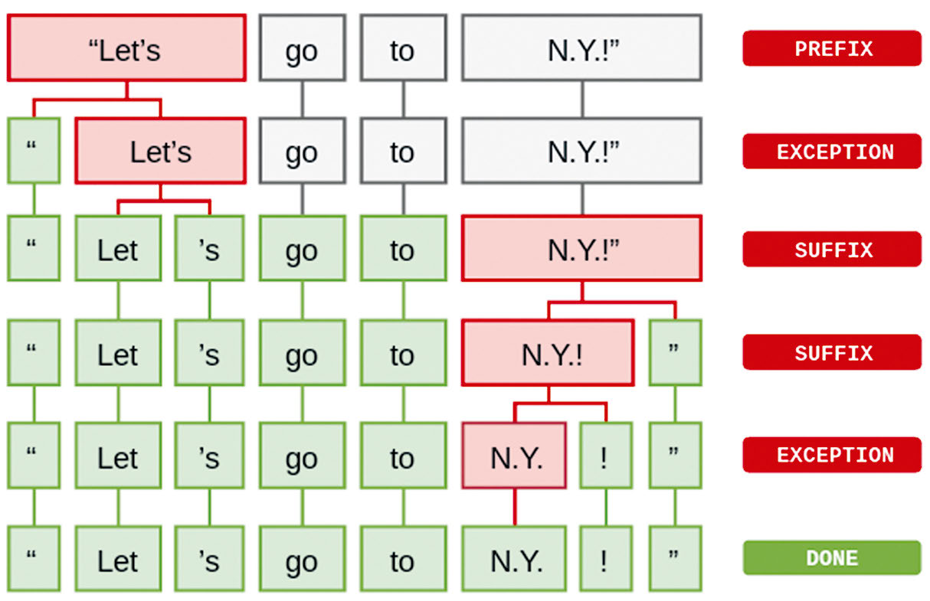
Natural Language Processing: Tokenization
Identification of tokens within a sentence.
A token can be a word as well as a special character like interpunctuation.
Explosion AI, Linguistic Features · spaCy Usage Documentation: Tokenization, https://spacy.io/usage/linguistic-features#tokenization

Slide 29
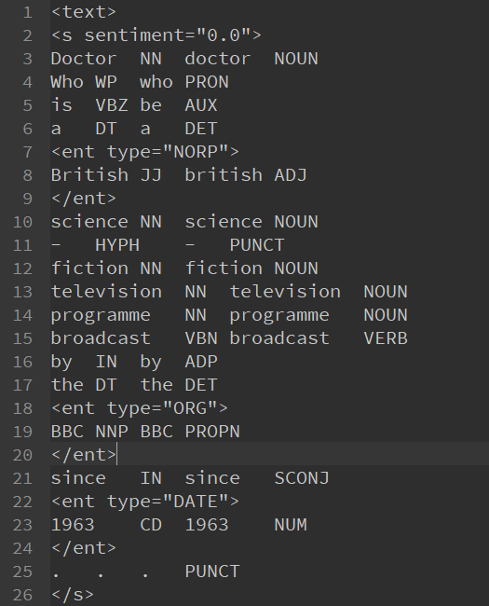
Natural Language Processing – annotation layers (with Spacy English 3.4.1)
Annotation text structure: text starts here
Annotation sentence: sentence starts here
Annotation of sentiment (value: 0.0)
Annotation Part of Speech PoS (tag: NN)
Annotation Lemma is → be
Annotation Simple Part of Speech simple_PoS
Annotation Named Entity (NER) (here: BBC as an Organisation
Annotation sentence: End of sentence

Slide 30
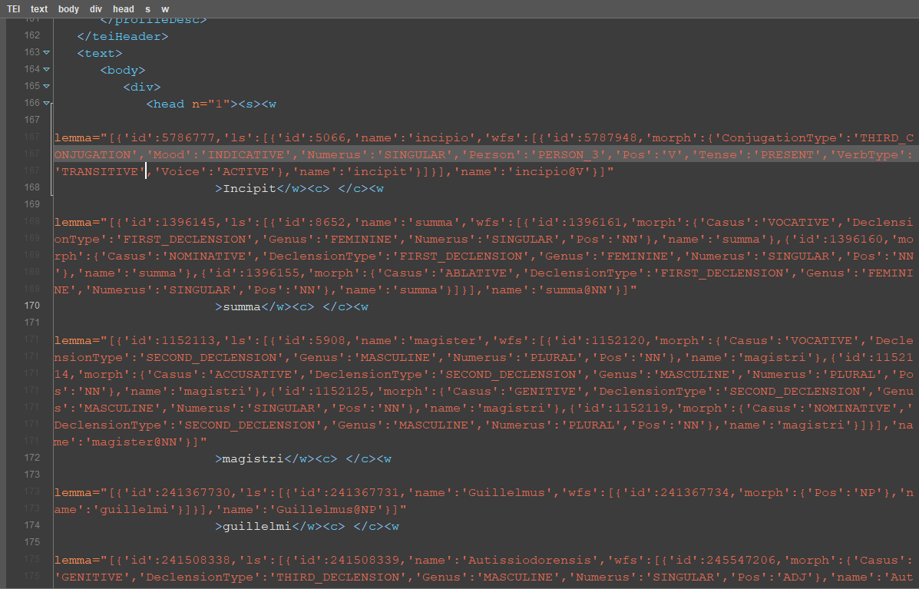
Lemmatized TEI/XML-file of Guillaume d‘Auxerre: Summa de officiis ( with the Frankfurt TTLab Tagger)

Slide 31
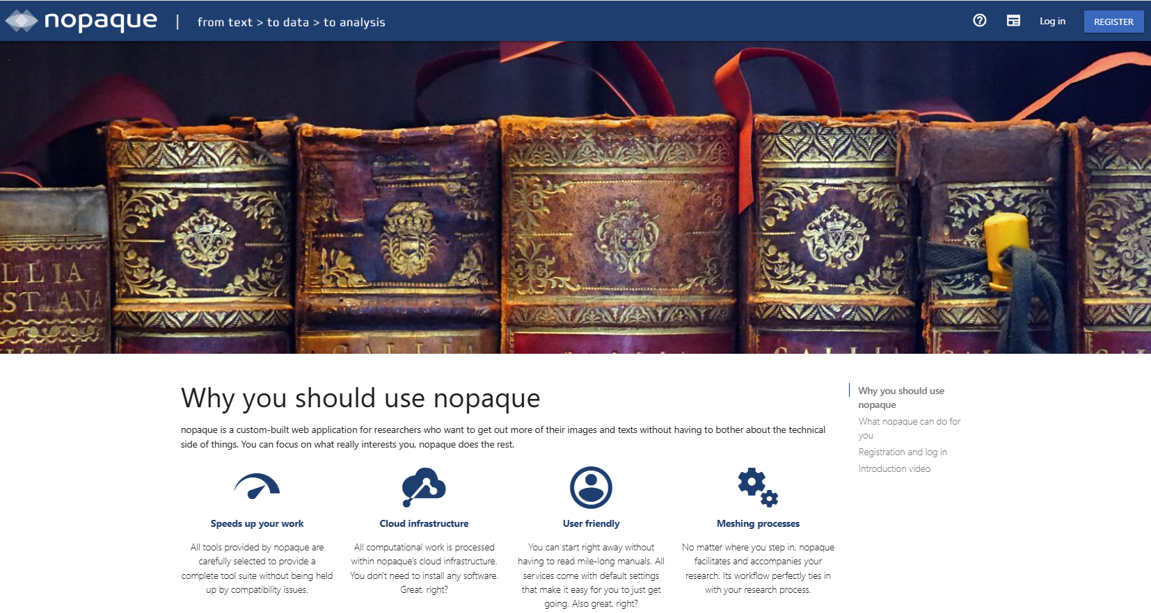
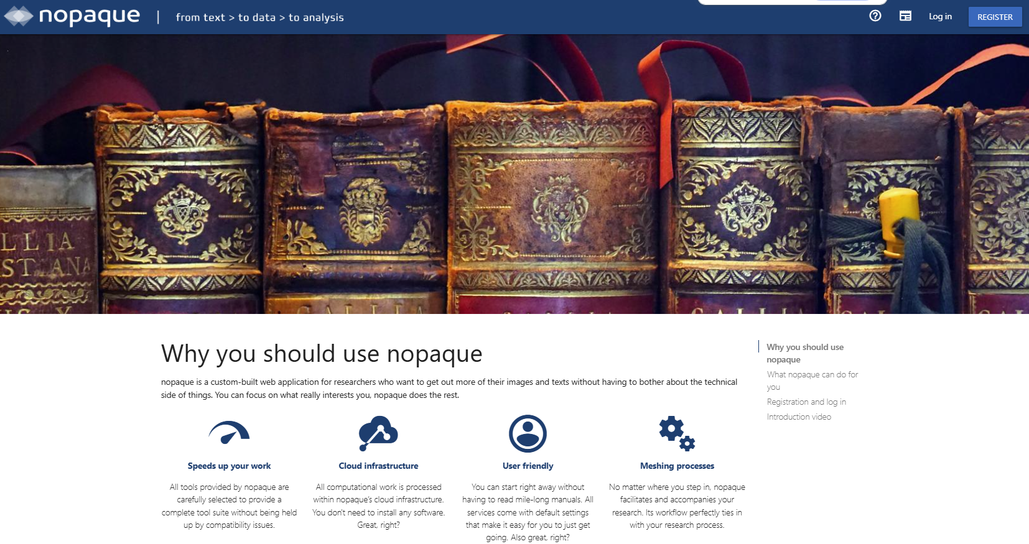

Slide 32
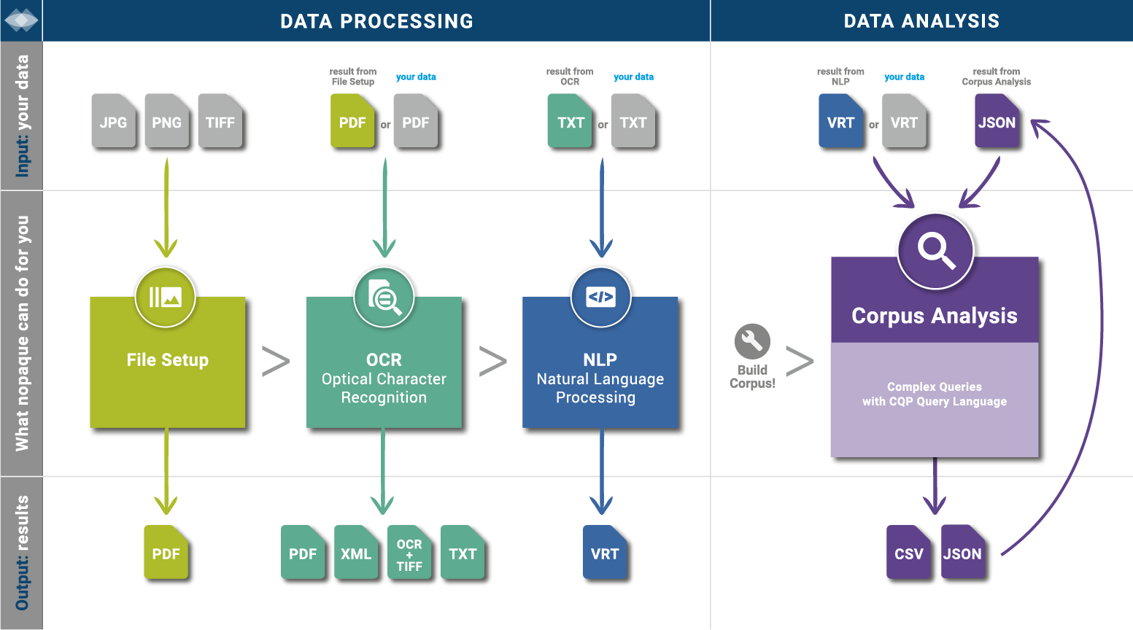

Slide 33
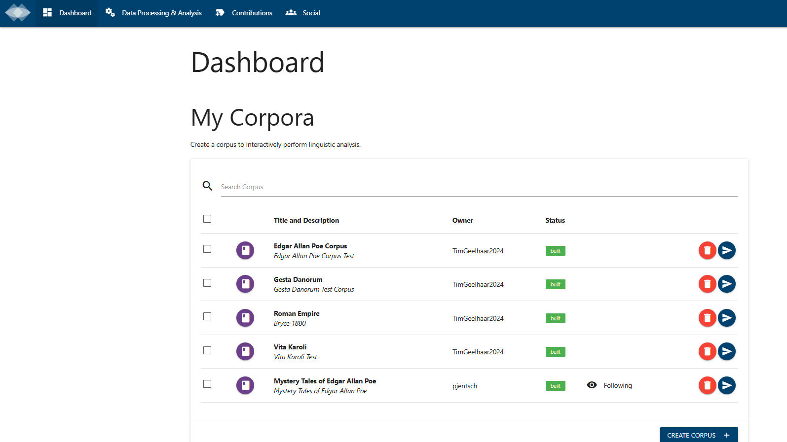

Slide 34
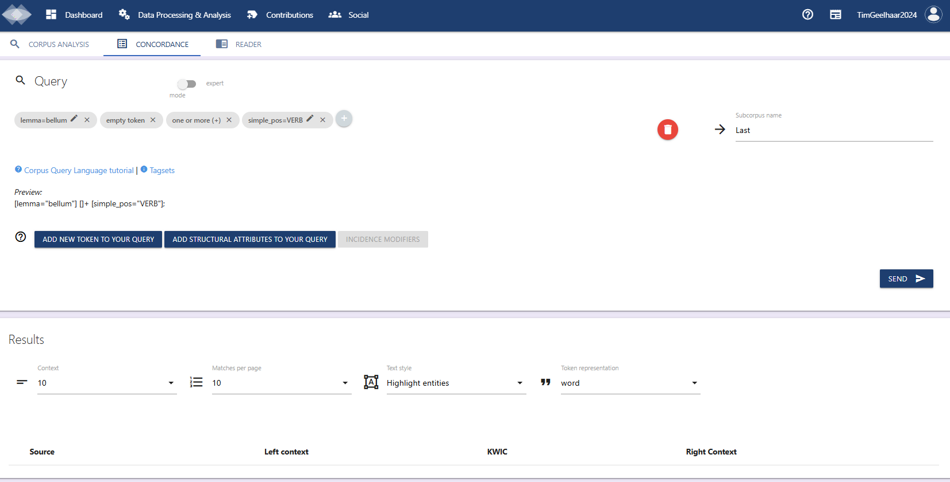
Exemplary query for the lemma bellum followed by verbs with a undefined number of tokens (words) in between

Slide 35
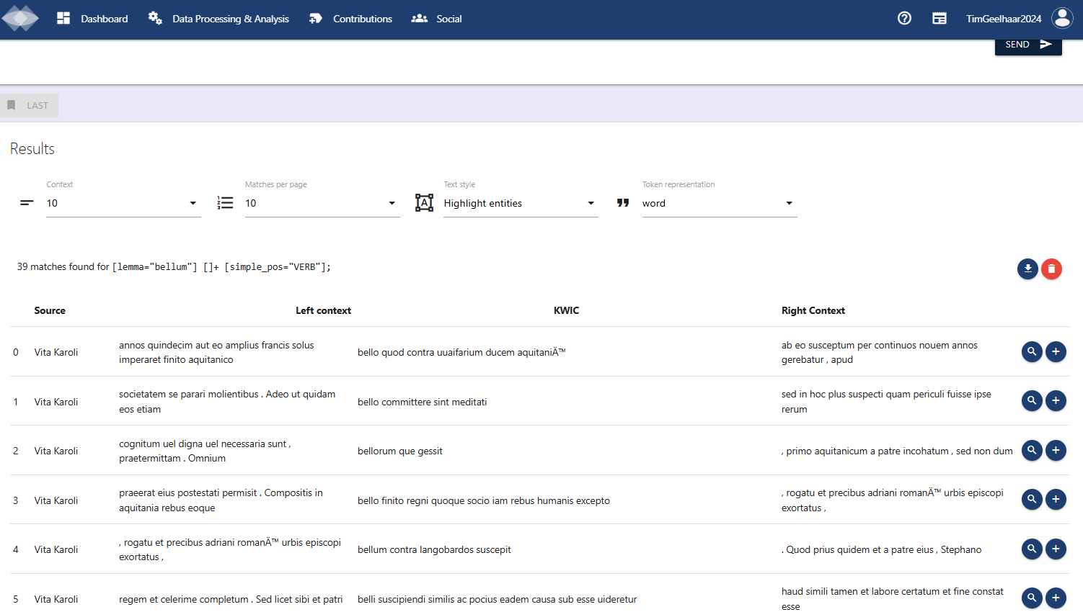
Corpus search results in Nopaque

Slide 36
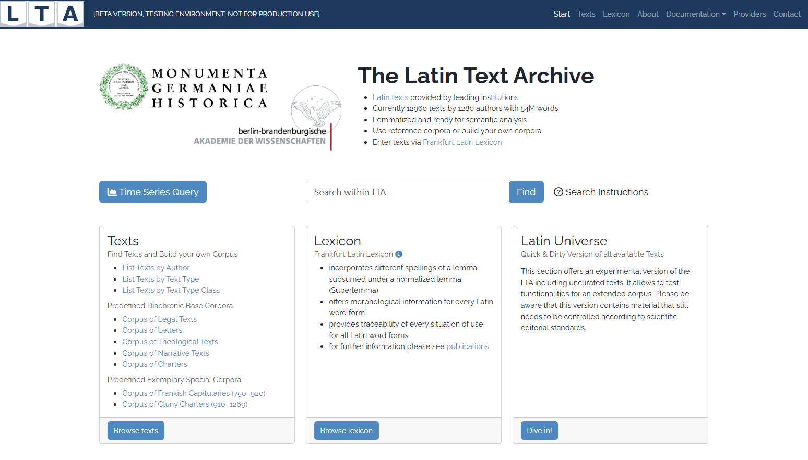
https://lta.bbaw.de

Slide 37
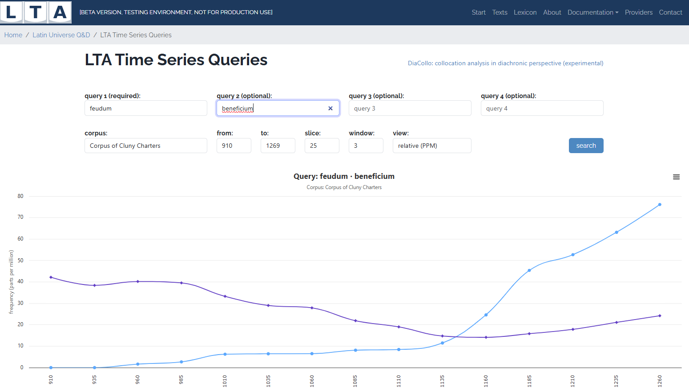

Slide 38
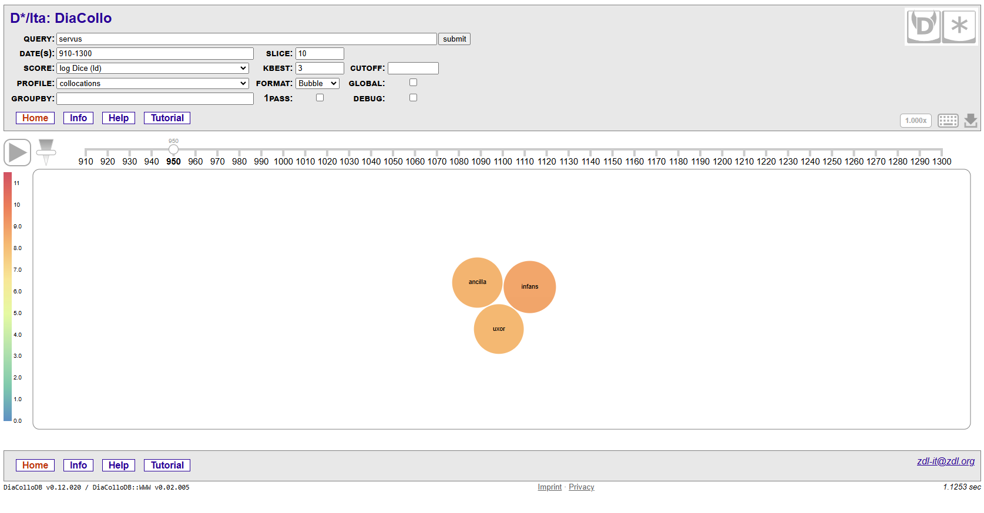
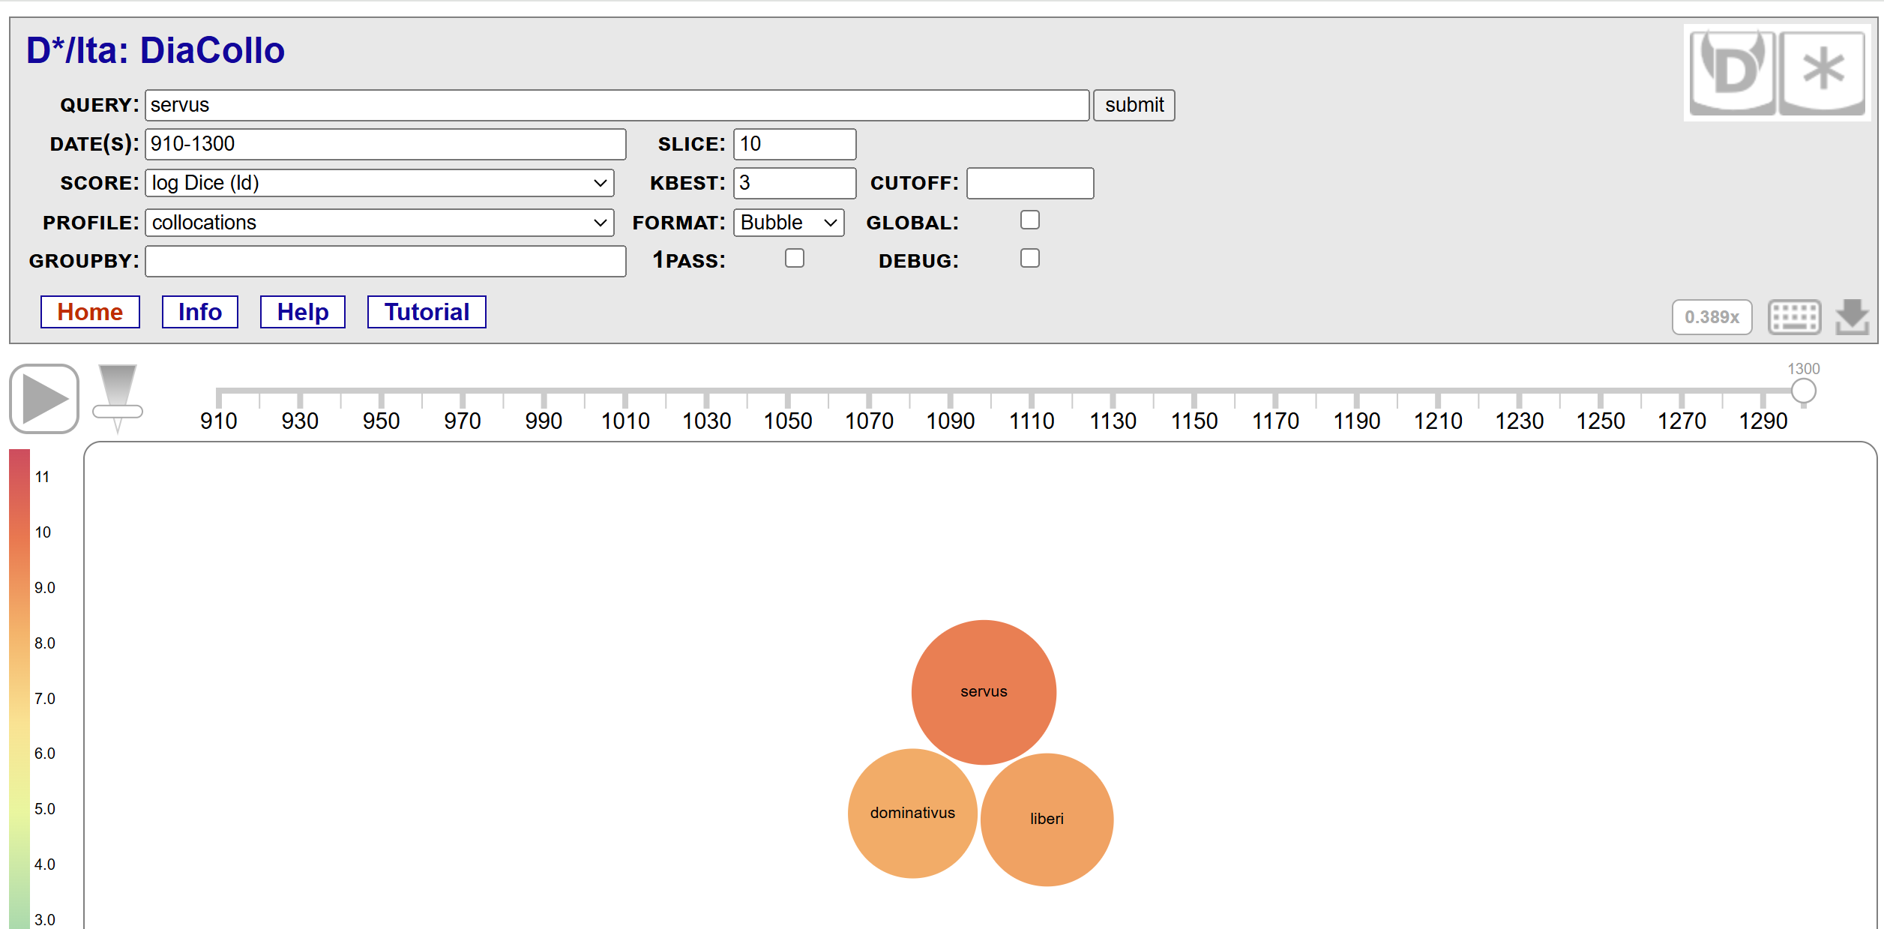

Slide 39
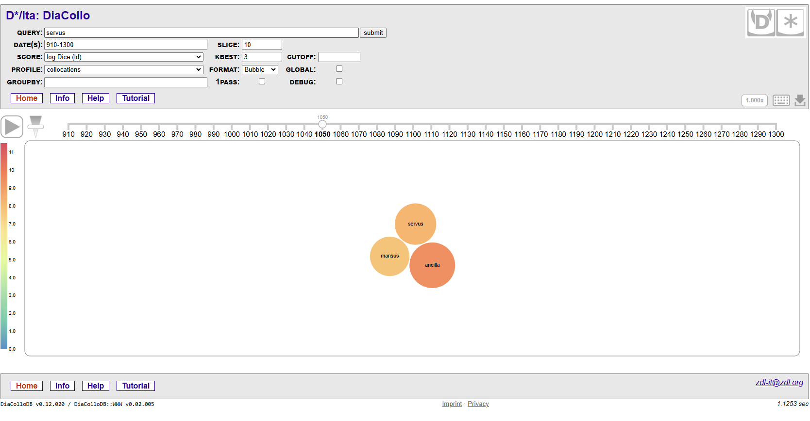

Slide 40
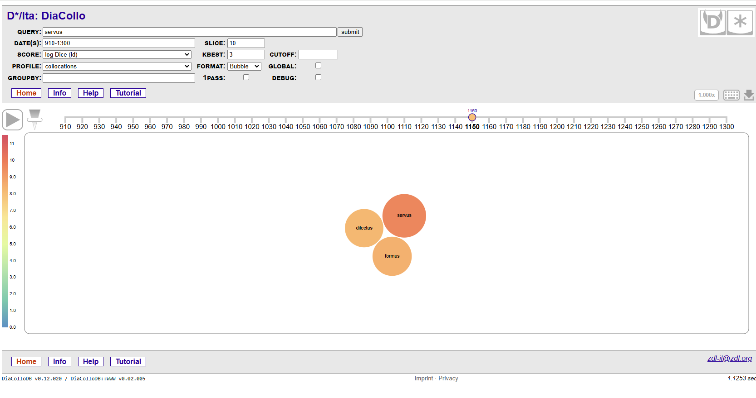
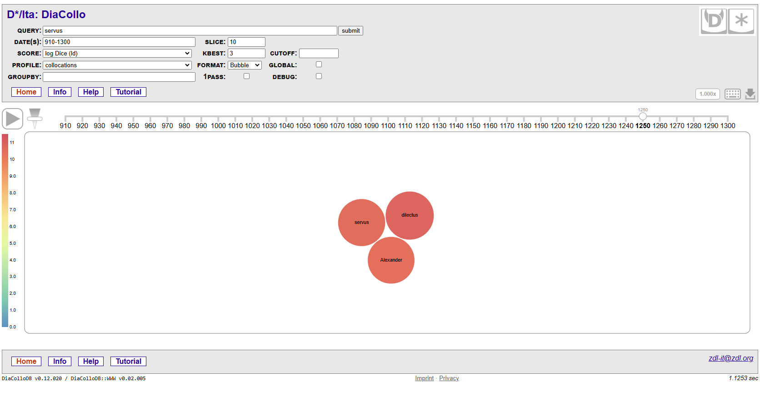

Slide 41
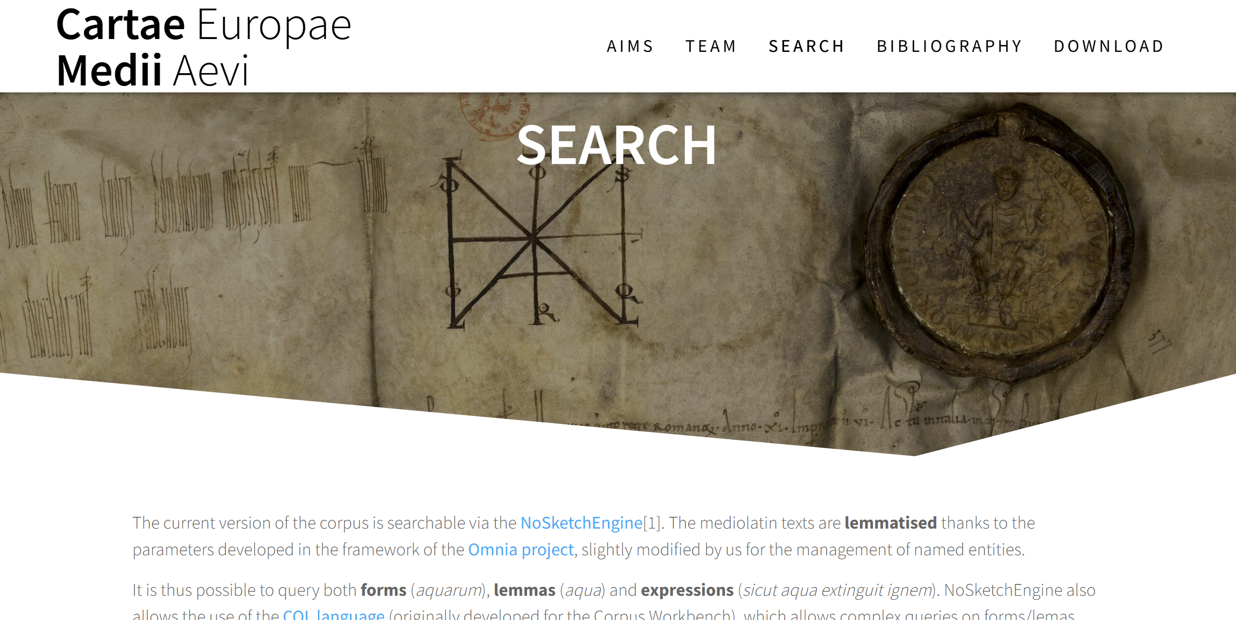
Existing databases with text mining tools: CEMA (Paris I, Lamop)
https://cema.lamop.fr/search/#page-content

Slide 42
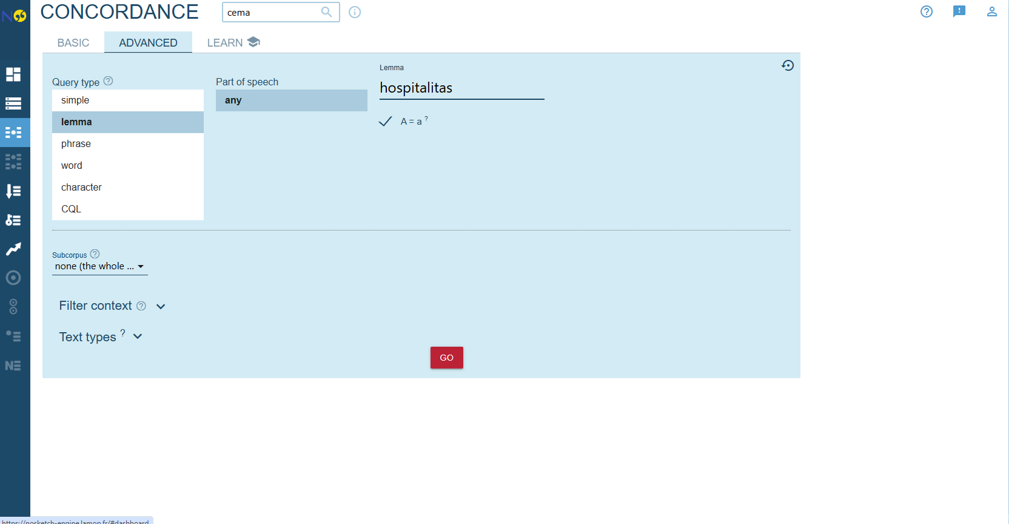

Slide 43
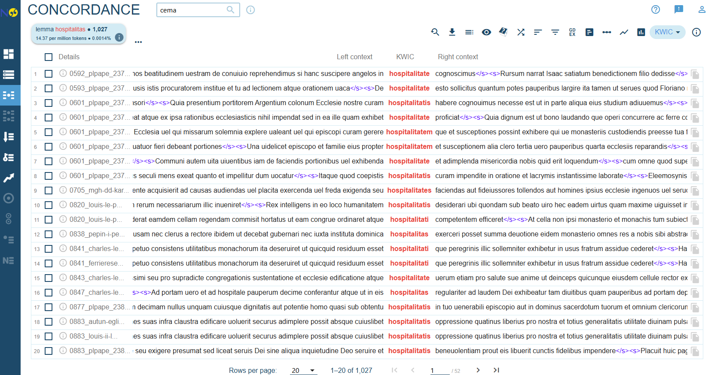
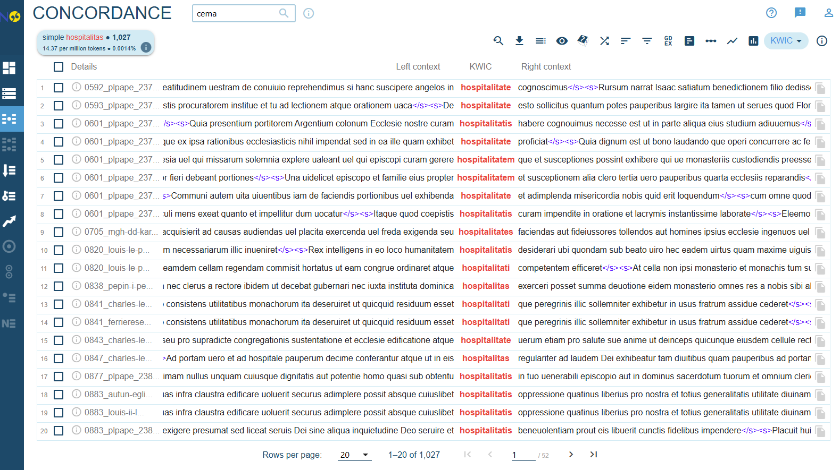

Slide 44
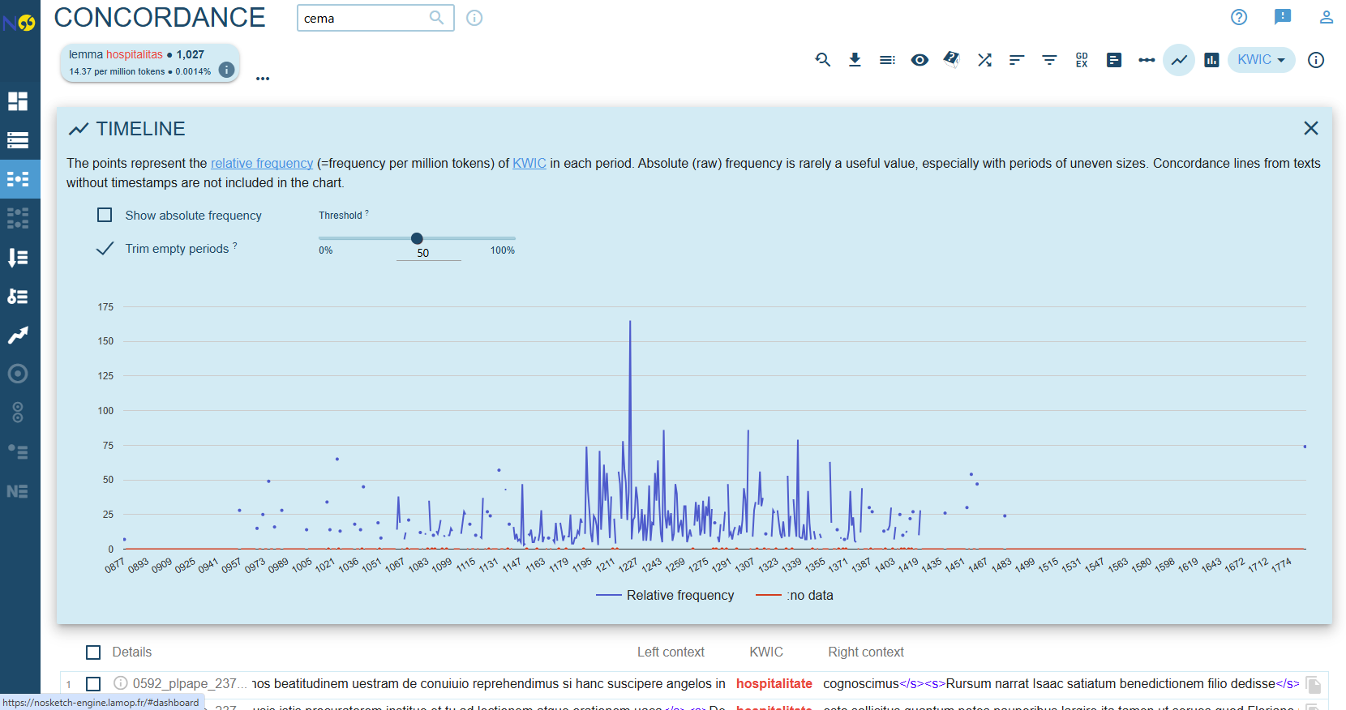

Slide 45
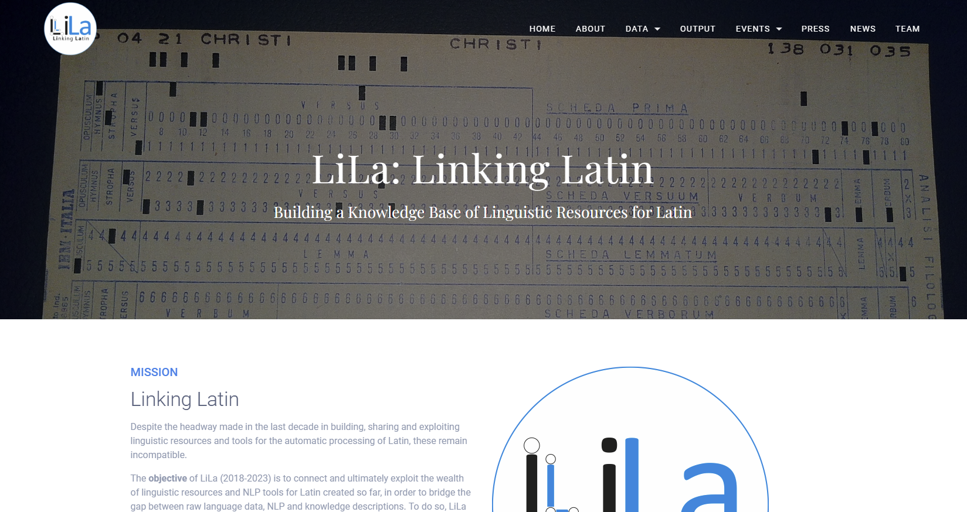

Slide 46
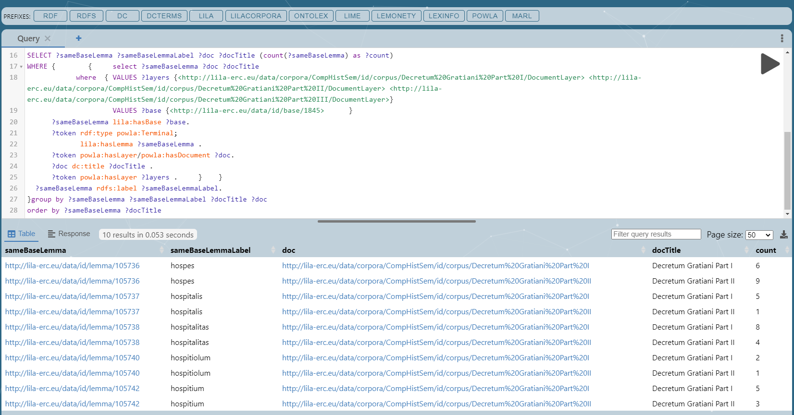
SPARQL-Query in the Linking Latin Triplestore (SPARQL Protocol and RDF Query Language)
hospes 15
hospitalitas 12
hospitalis 6
hospitiolum 3
hospitium 8

Slide 47
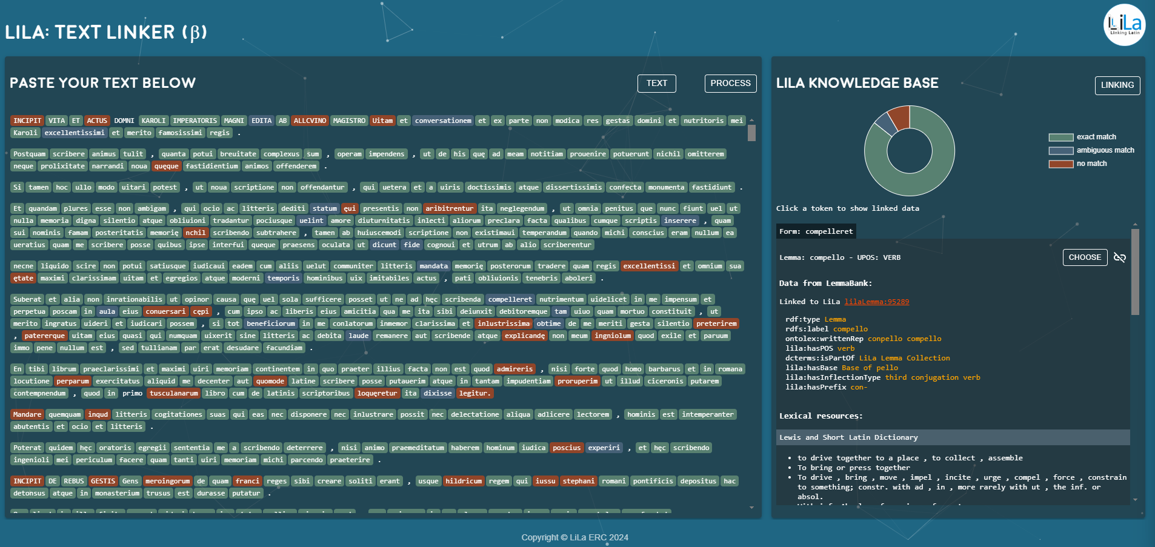
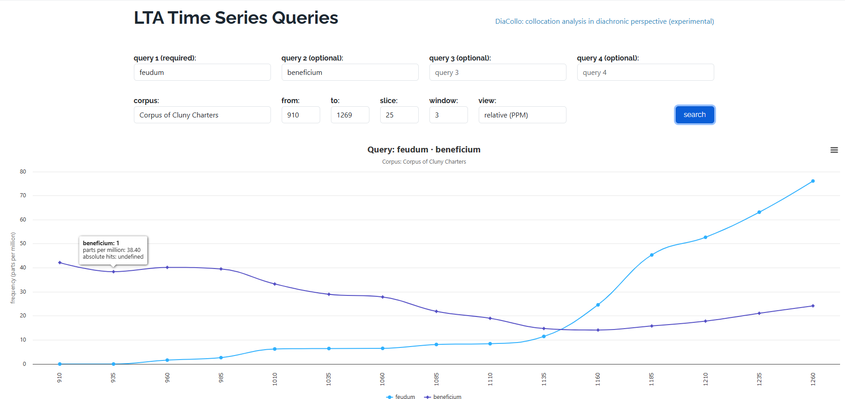
Text Mining: Linking Latin
https://lta.bbaw.de/r/plot?q1=feudum&q2=beneficium&corpus=cluny&start=910&end=1269&slice=25&window=3&norm=date

Slide 48
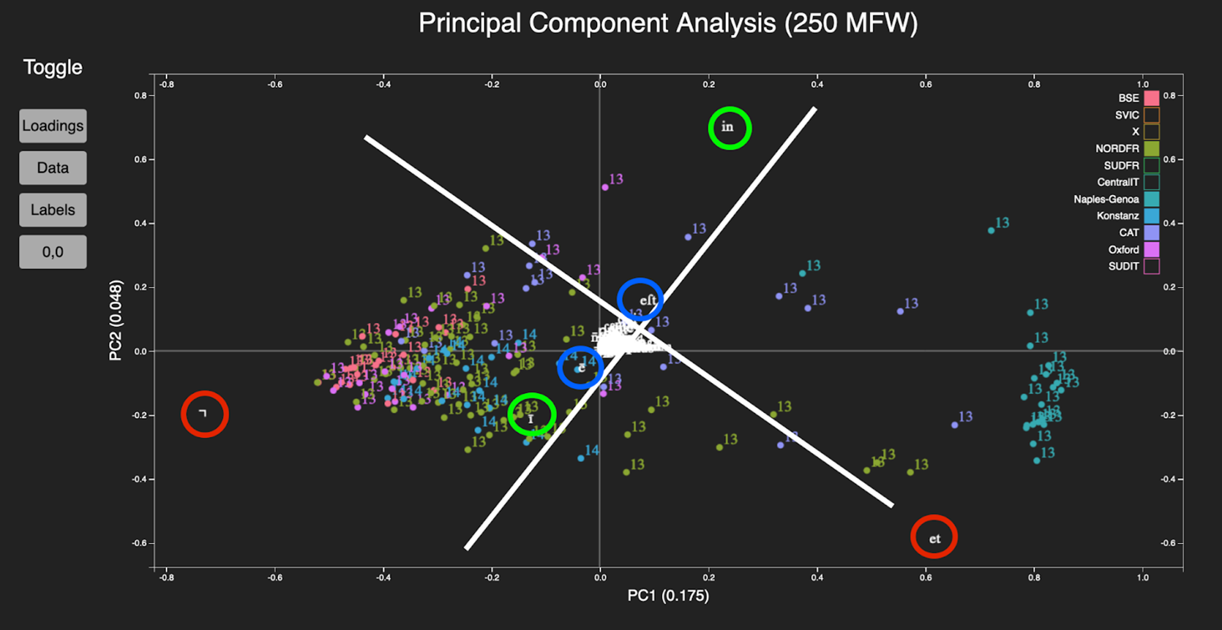
Distant analytics: Identifying clusters of manuscripts method: TF-IDF (Term Frequency – Inverse Document Frequency)
Notes:
Very distant analysis of textual characteristics, here common words and their abbreviations and how that are distributed
The Paris Bible Project aims to understand the production and diffusion of medieval Latin Bibles in Europe. A Paris Bible, also known as a Parisian Bible, is a format of Bible that is standardized in the 13th century
and spreads as a model through Europe. (in / ī and eſt / ē from top right to bottom left) and (et / ⁊) from top left to bottom right which are indicative of regions known from the localization of manuscripts. This tends to suggest that English scribes are more likely to use the Tirolian ampersand, whereas Italian or some French scribes preferred the two letter "et". A similar distinction is made between Catalonian and English scribes' preference for the preposition "in" and French scribes "ī".

Slide 49
Text mining for advanced scholars I
Natural Language Toolkit (NLTK) – a suite of libraries and programs for symbolic and statistical natural language processing (NLP) for the Python programming language.
spaCy – open-source Natural Language Processing library for Python
The programming language R provides a framework for text mining applications in the package tm
Stylometry: https://programminghistorian.org/en/lessons/introduction-to-stylometry-with-python
Sentiment Analysis: https://www.datacamp.com/tutorial/simplifying-sentiment-analysis-python
Topic Modeling: https://mimno.github.io/Mallet/topics.html
Karsdorp, Folgert; Kestemont, Mike; Ridell, Allen, Humanities data analysis: case studies with Python, Princeton/Oxford 2021 9780691172361
Schuster, Kristen; Dunn, Stuart, Routledge International Handbook of Research Methods in Digital Humanities, London 2020 9780429777028
Wagh, Sanjeev; Bhende, Manisha; Thakare, Anuradha, Fundamentals of data science, Boca Raton/London/New York 2022 9780429811470

Slide 50
Text mining for advanced scholars II
Keep in mind that the versions of each program need to be applicable for each other, e.g. LatinCy requires Spacy 3.7.5 which in turn requires Python 3.12.8
The path variables need to be checked and if needed adjusted.
 | Windows | Linux
System prerequistes | Windows Subsystem for Linux (WSL) Git
Programming languages: | Python, R, Java | Python, R, Java
Integrated Development Environment (IDE) | VS Code, R Studio | PyCharm, IntelliJ, VS Code, R Studio
XML-Editor | Notepad++ with extensions; Oxygenxml (paid) | Notepad++ with extensions; Oxygenxml (paid)
Text processing | NLTK, CLTK, Spacy, Regular Expressions Open refine / for R: tm, text, snowballC, | As windows
Vectorization/Encoding | Matlibplot, seaborn, pyLDAvis / for R: wordcloud, ggplot2 | As windows
Advanced NLP | transformers (Hugging Face): Pre-trained language models like BERT, GPT. | As windows
Topic Modeling | Mallet (requires Java), gensim / for R: topicmodels | As windows

Slide 51
Text mining – some last thoughts
Widens our view on texts and intertextuality considerably
Outperforms the reading capacity of a single person
Allows comparison at higher levels (up to global level)
Helps to establish source-based general statements
Produces new reusable data, thus enhancing research
AI is not replacing text mining methods on a scientific level
Demands a lot of preprocessing and to learn new tools & techniques
Requires to learn how to visualize and interpret data
Danger of getting lost on the way, it does not reduce the workload
Tools get outdated, need to stay up to date
Requires a larger historical background knowledge to come to conclusions

